Slide 1
A-Level: Fashion & Textiles
A guide to the course at Wallingford School

Slide 2
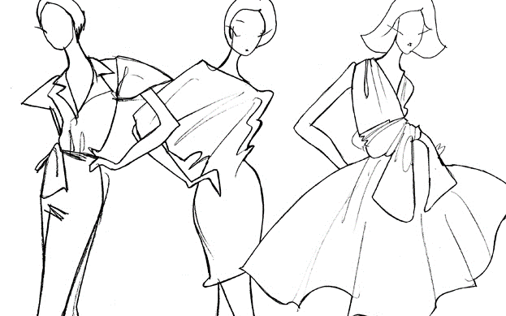
Why choose fashion & textiles?
Are you creative and imaginative?
Do you enjoy exploring ideas and looking at things in different ways?
Do you enjoy making?
If so, A-Level Fashion & Textiles is the course for you!
You will enjoy developing your understanding of the visual world, learning practical skills and responding to ideas and issues in ways that are personal to you.

Slide 3
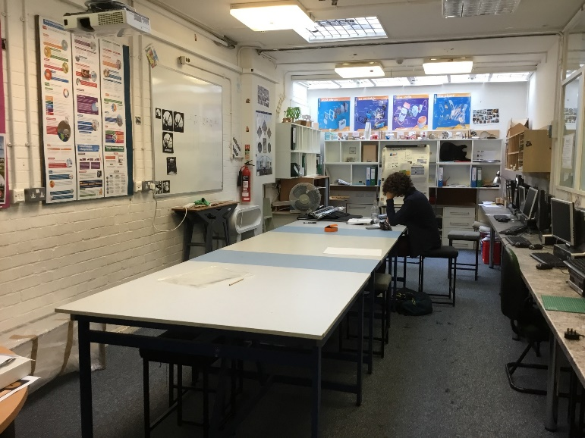
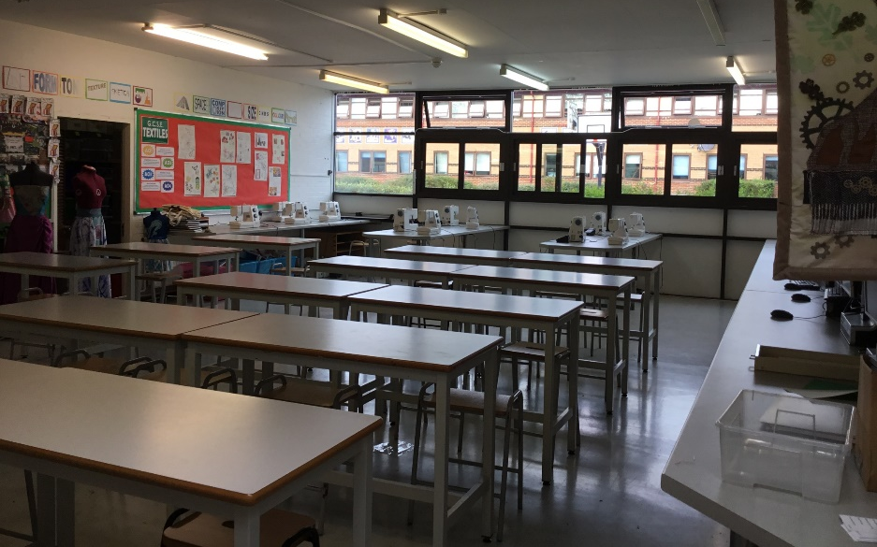
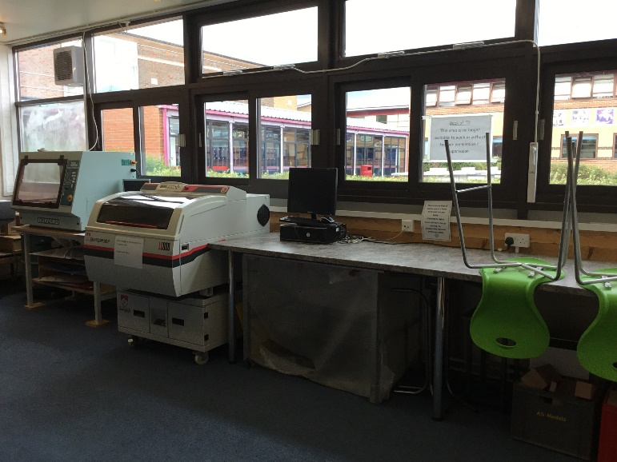
Teachers and Classrooms
Teaching of the course is shared between Miss D Isaac and Miss J Dornin.
We have been teaching A-Level Fashion & Textiles for many years and both have a background in Costume Design.
We have a dedicated Textiles room (T5) where the majority of lessons are taught. We encourage students to work in the DT department during study periods – we can always find space for you either in T5, T2B (our Sixth Form classroom) or T3 (the DT computer room).

Slide 4
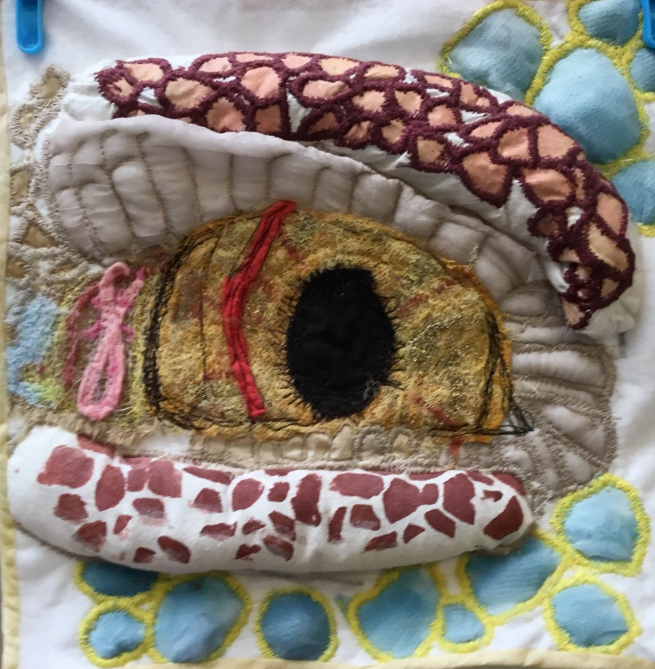
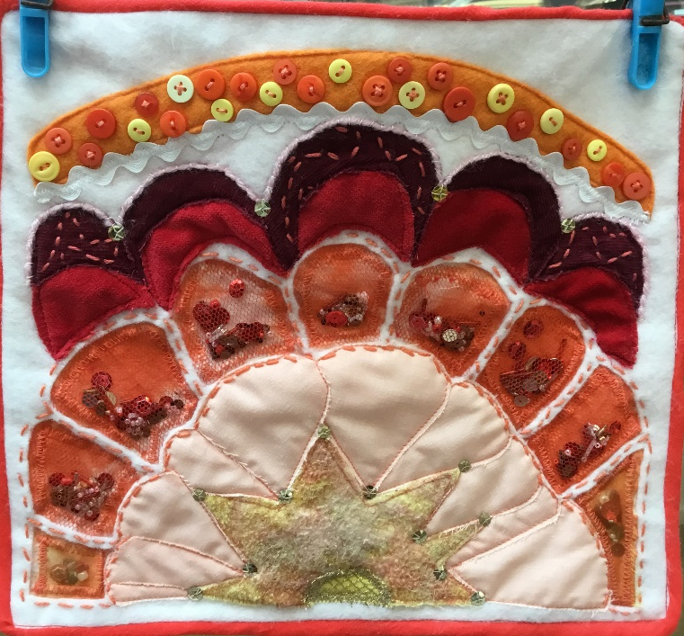
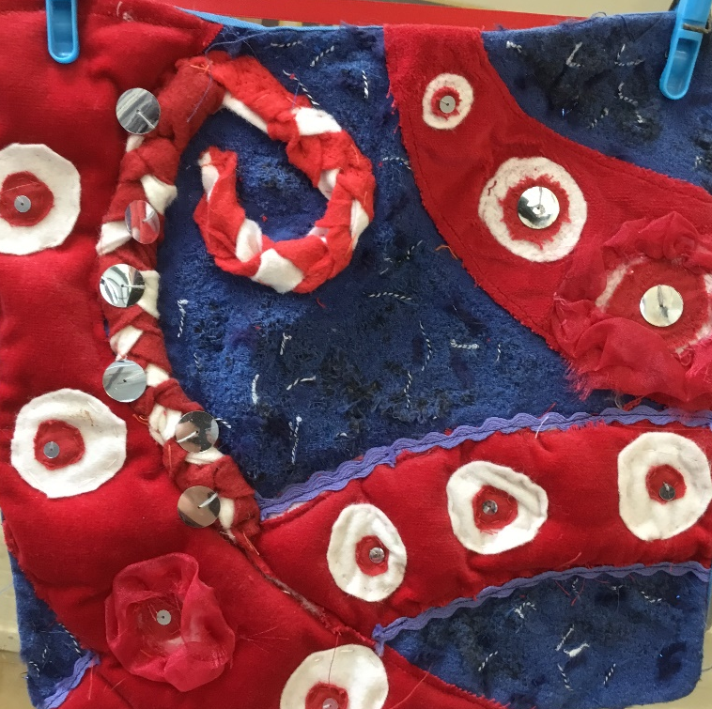
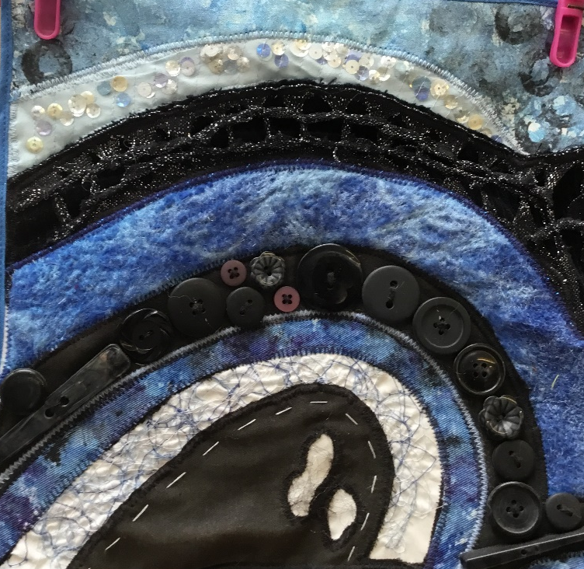
What will I learn?
In Year 12 you will undertake a variety of different projects designed to expand your textiles knowledge and practical skills.
You will:
Develop sketching and designing techniques using a variety of different media and materials.
gain knowledge of past and current fashion designers and use their work to inspire your own designs,
learn how to draft patterns for your products,
investigate a range of surface decoration techniques such as dyeing, encapsulation and batik.

Slide 5
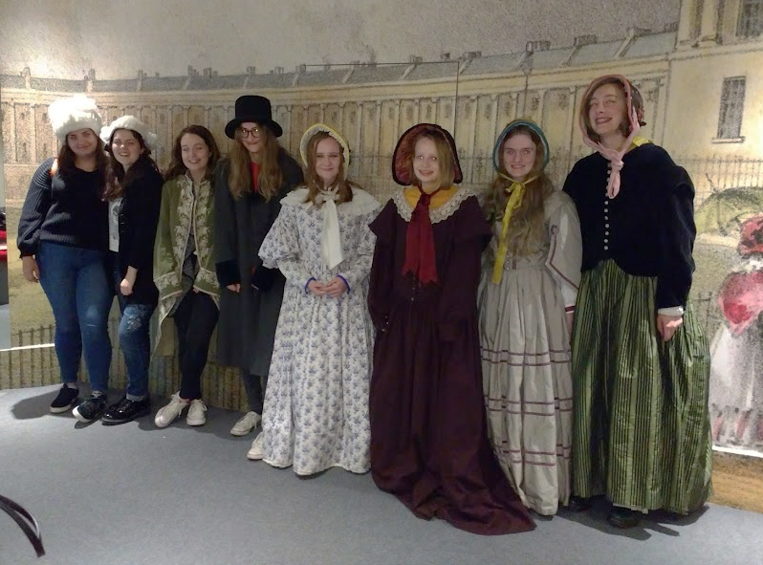
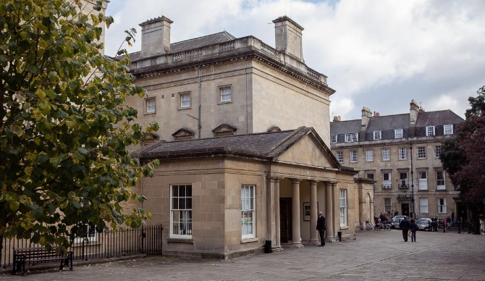
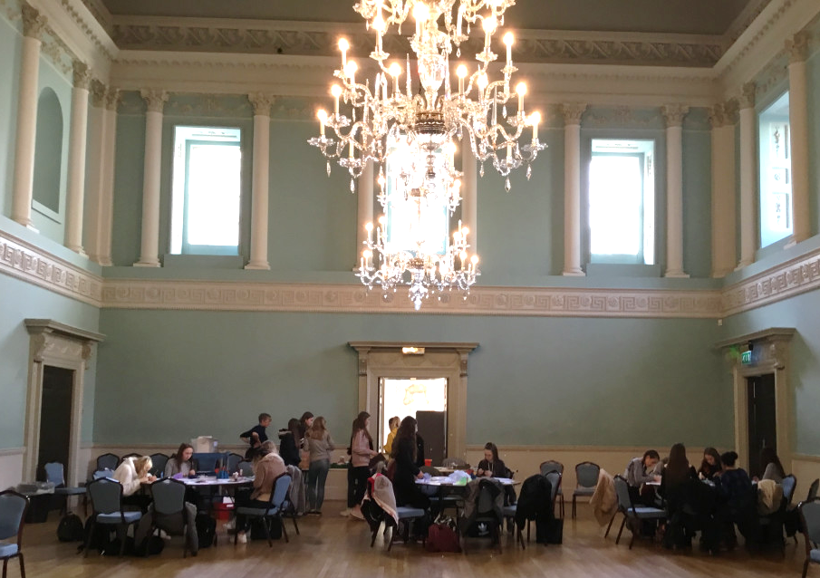
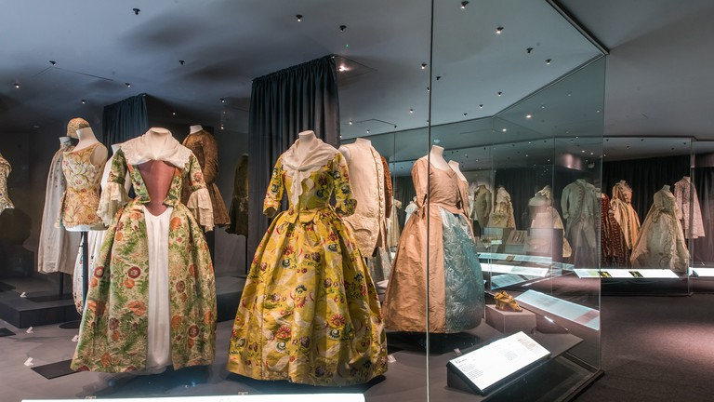
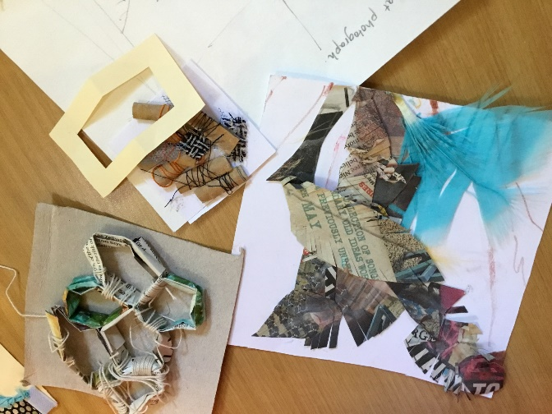
Trips and visits
We organise a variety of trips and visits to support and inspire your project work.
A main stay of our A-Level course is our annual trip to the Fashion Museum in Bath.
Students have experienced workshops at the museum including Take one designer – Sarah Burton for Alexander McQueen, Manipulating fashion and Techniques with textiles.

Slide 6
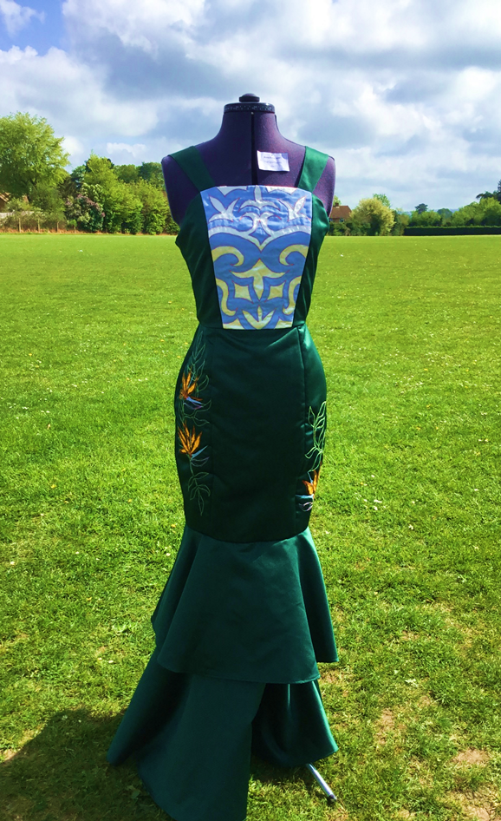
A-level assessment
This is a two year course with assessment taking place at the end of Year 13. There are two components:
Component 1: “The Coursework Portfolio”
A personal investigation into an idea, issue, concept or theme supported by written material. This will count for 60% of your total A-level marks.
Component 2: “The Exam Project”
A personal response to one of eight exciting starting points, set by AQA, which will count for 40% of your total A-level marks.

Slide 7
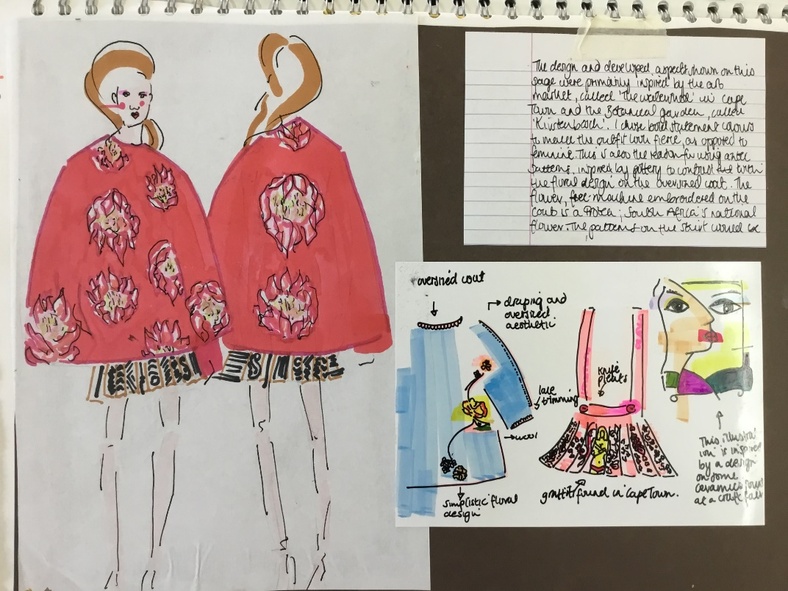
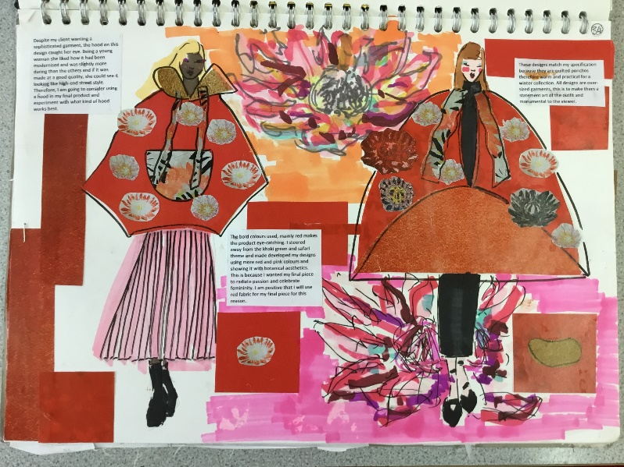
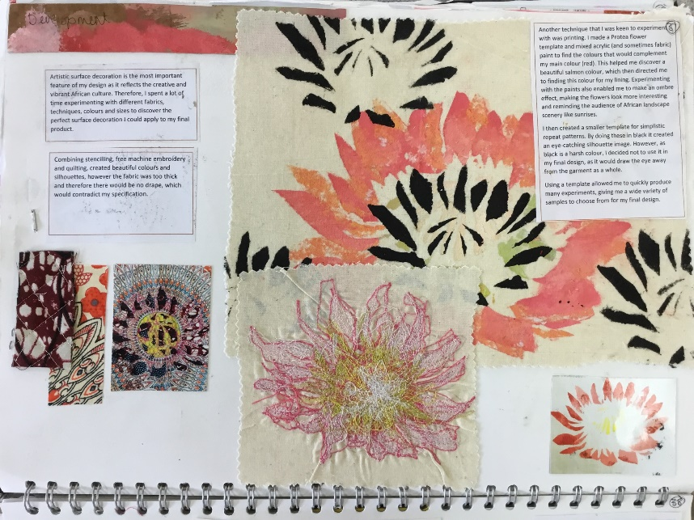
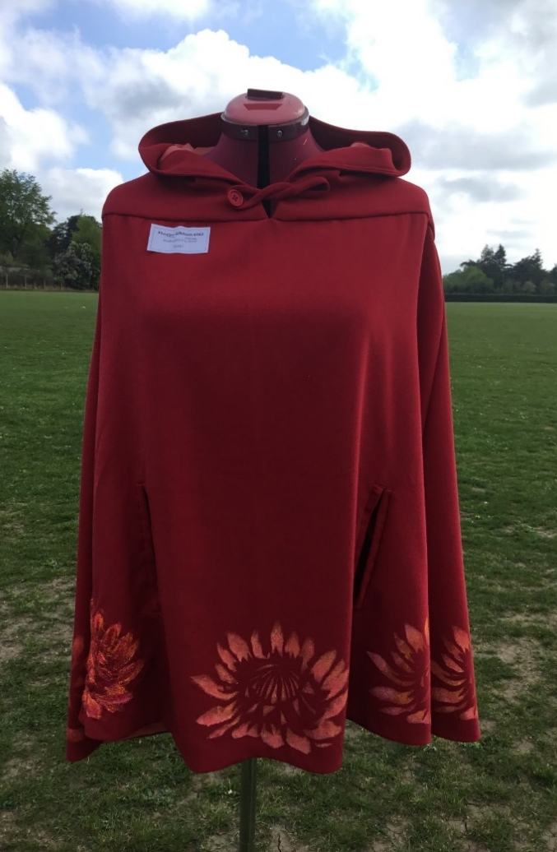
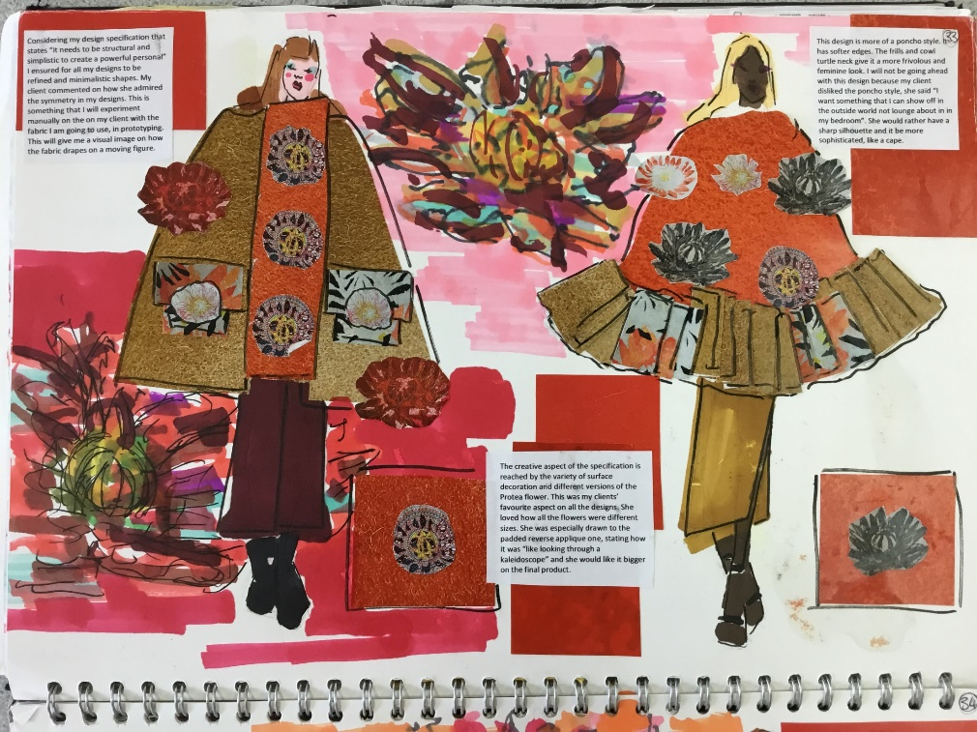
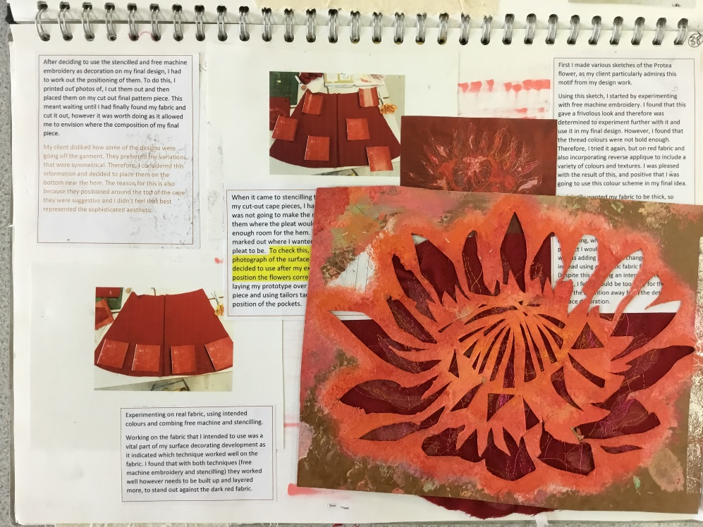
Some examples of Work from previous years

Slide 8
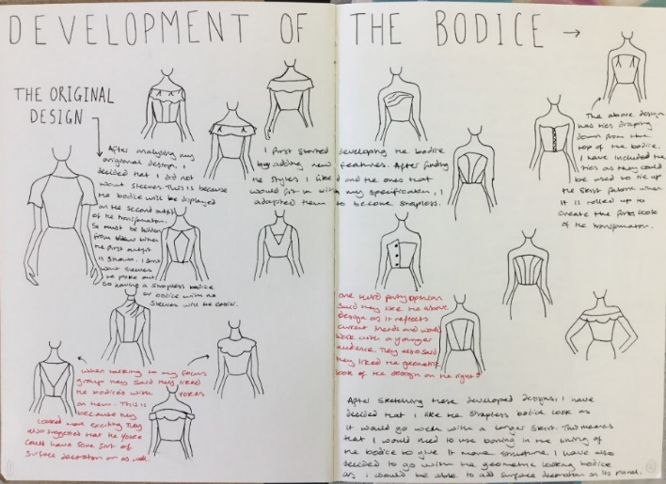
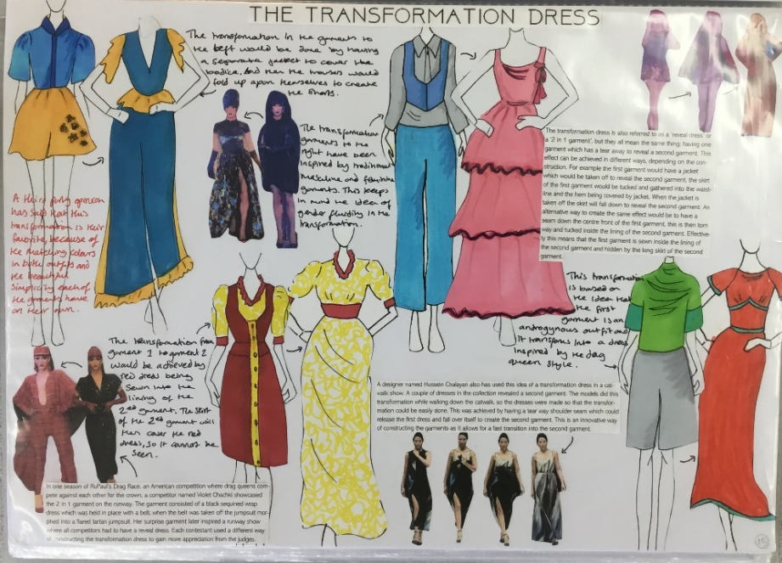
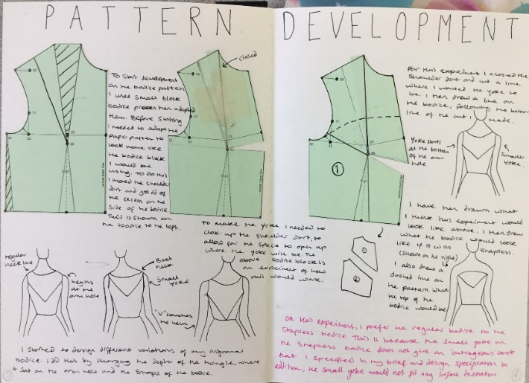
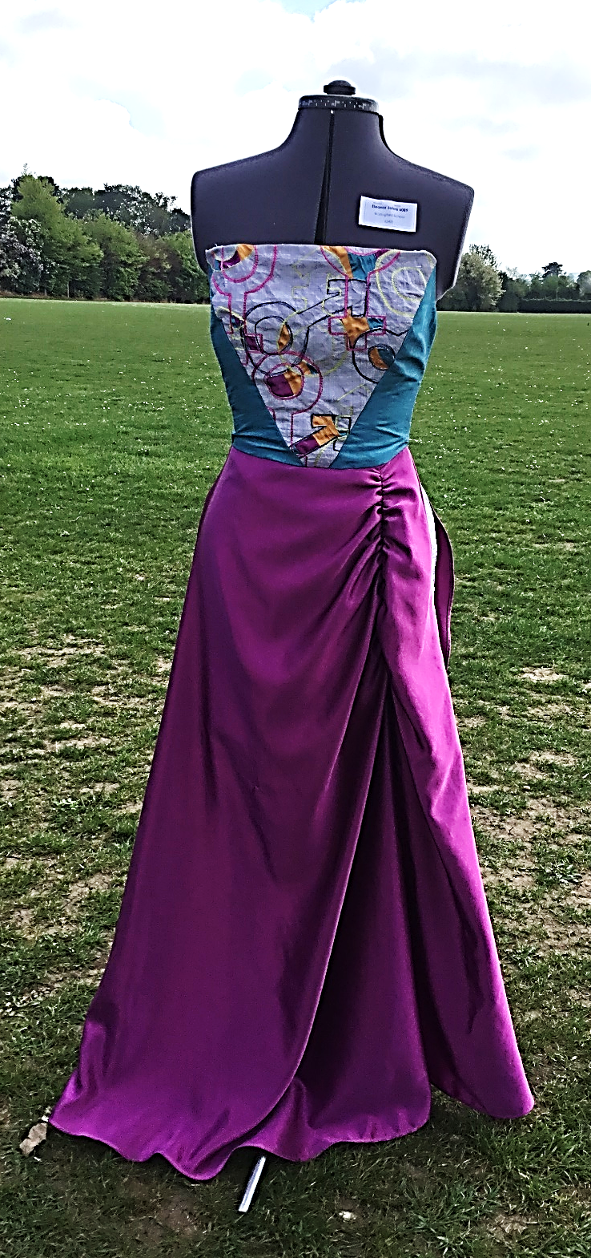
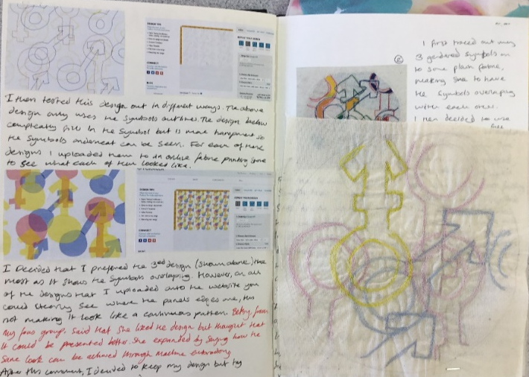
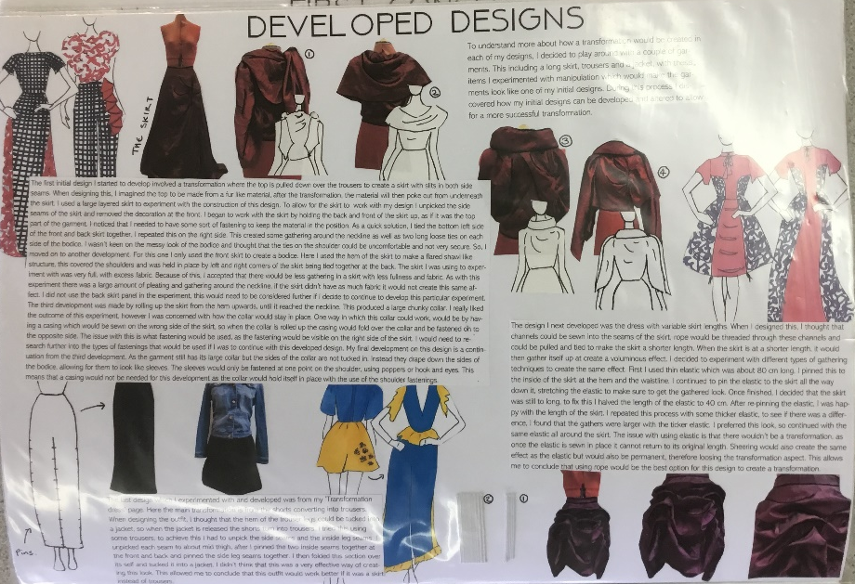
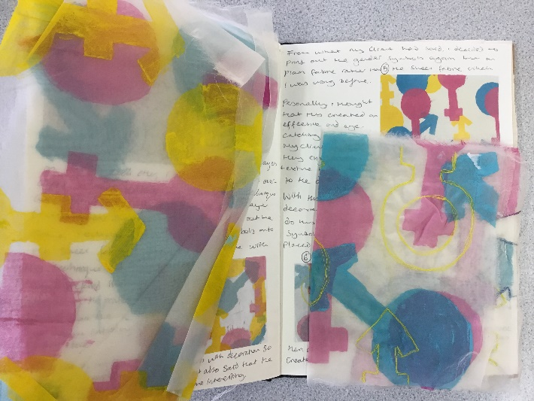
Some examples of Work from previous years

Slide 9
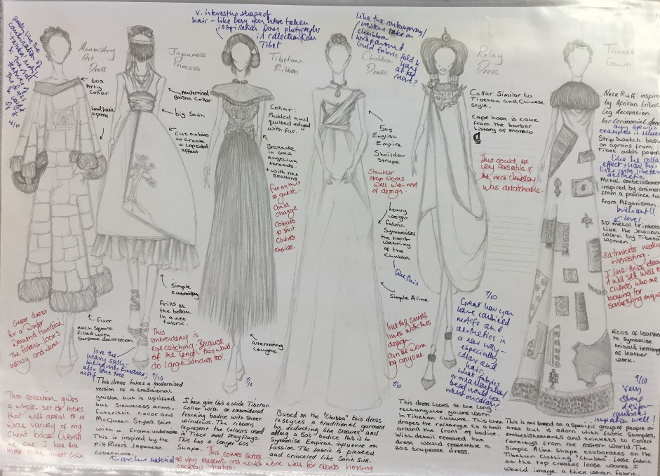
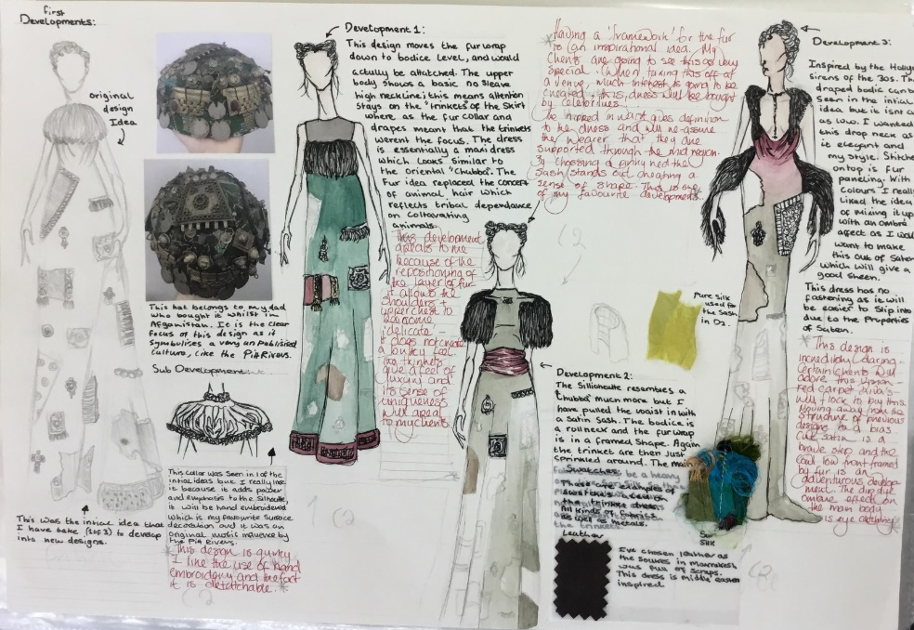
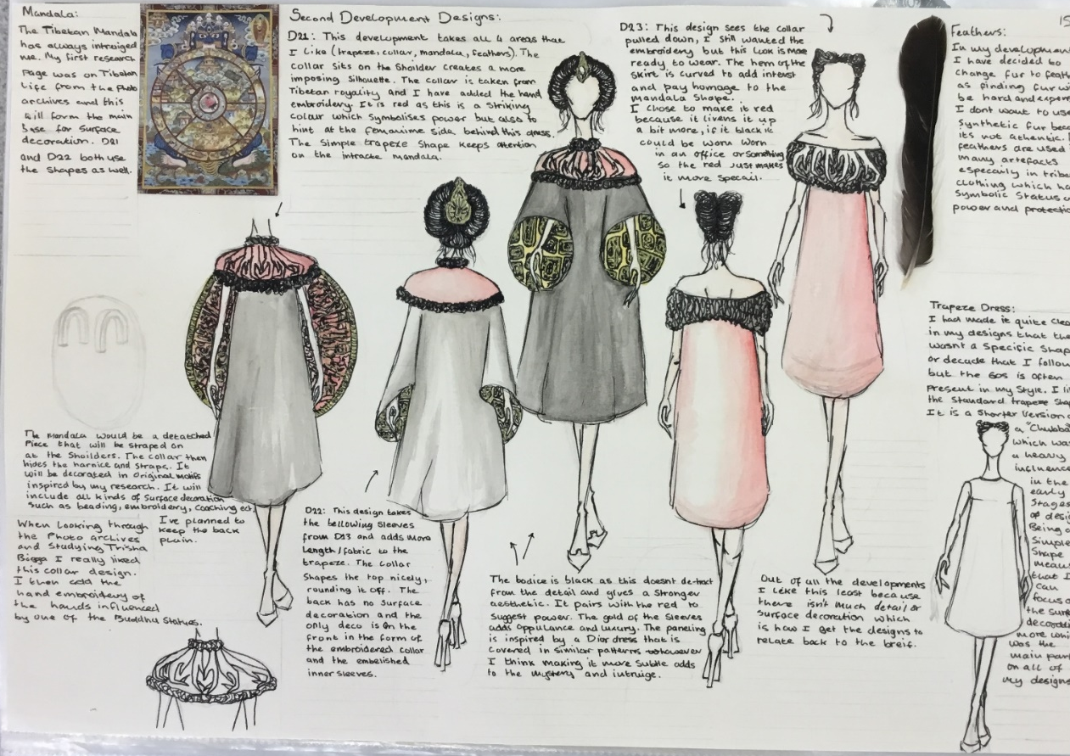
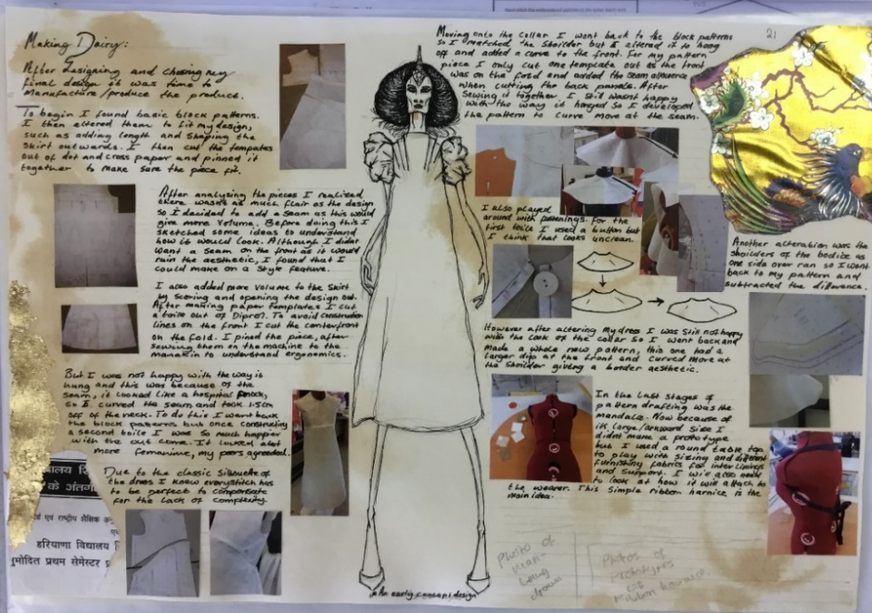
Some examples of Work from previous years

Slide 10
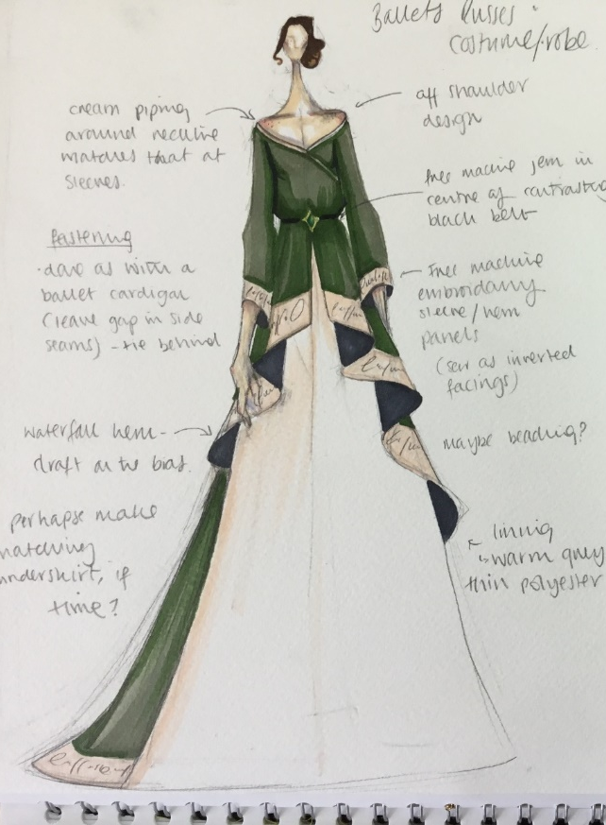
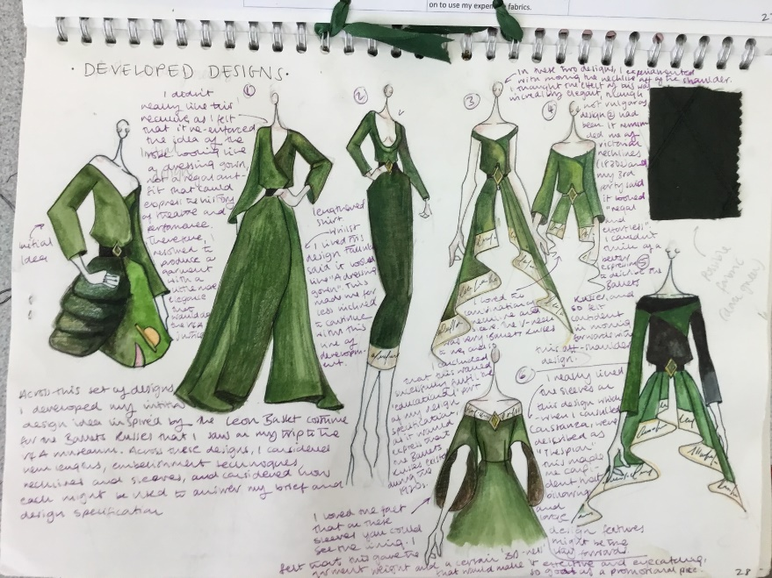
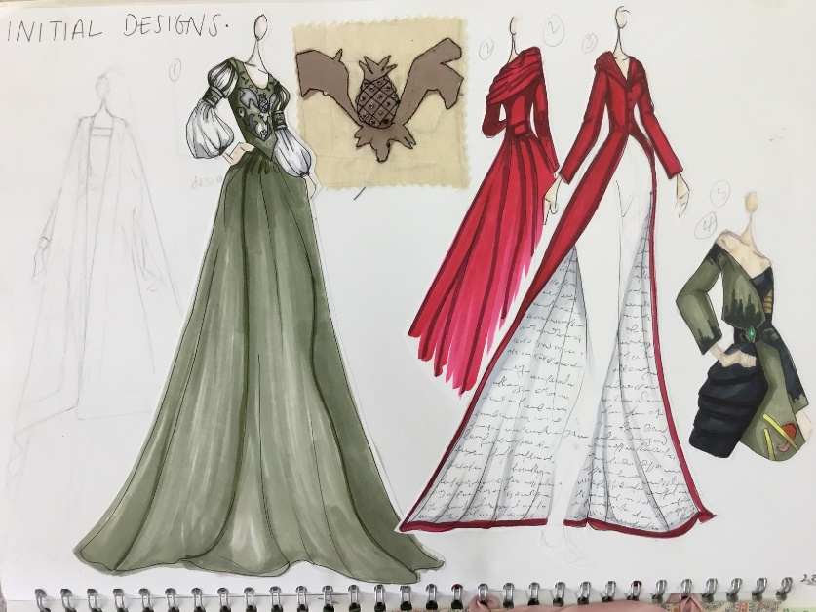
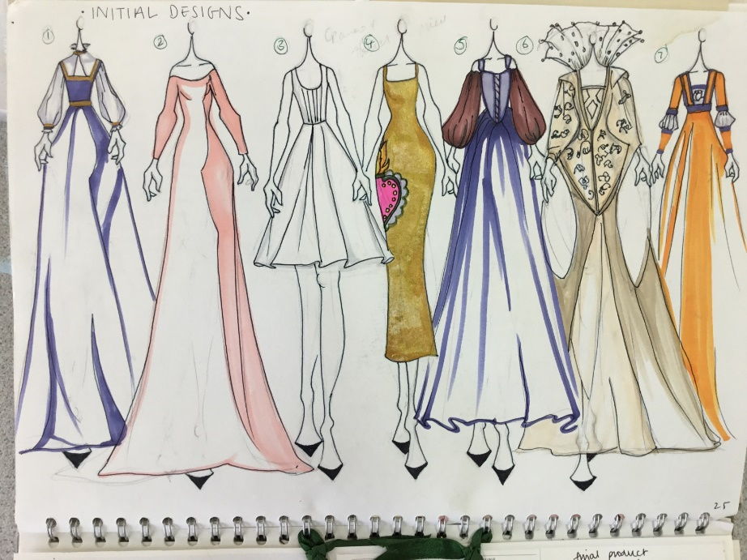
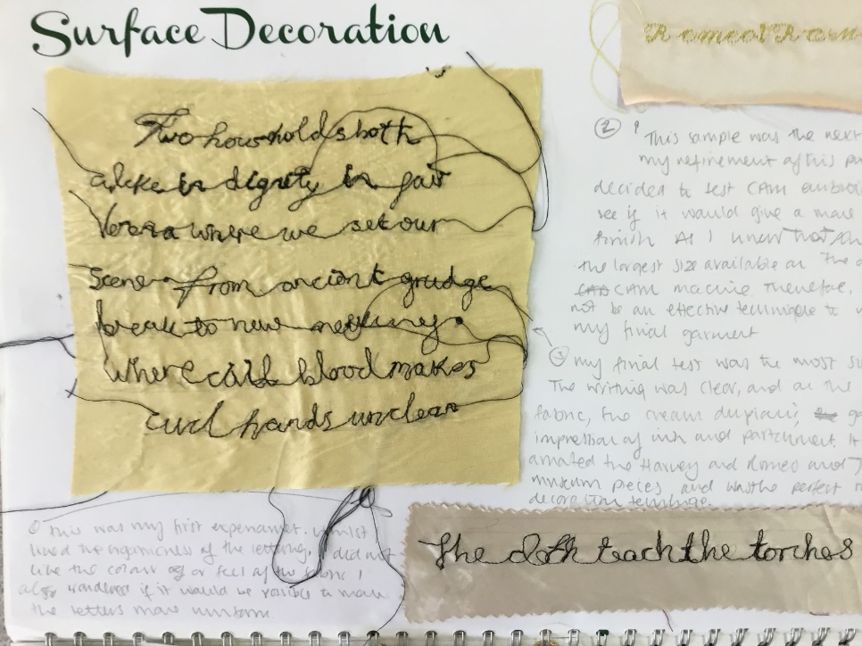
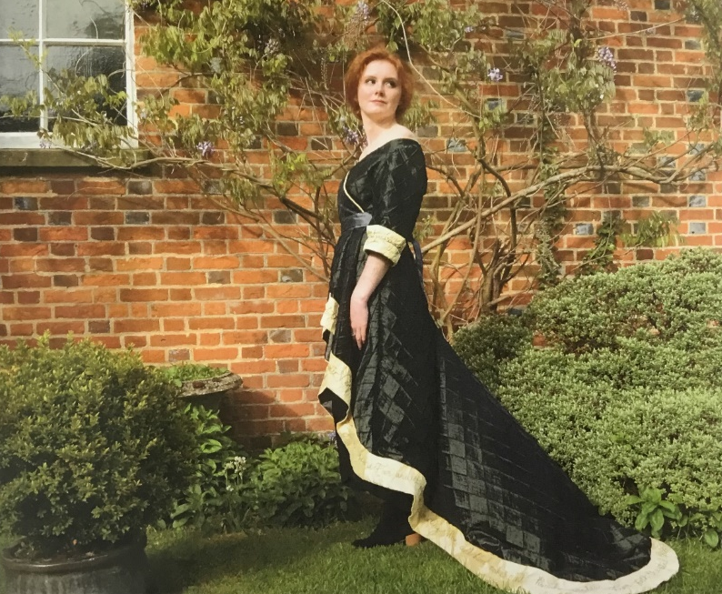
Some examples of Work from previous years

Slide 11
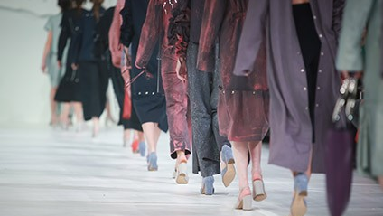
Beyond A-level fashion & textiles…
Possible career options:
Textile technologist • Colour trender or stylist• Costume designer • Creative director • Digital textiles designer • Fashion designer • Fashion illustrator • Fashion journalist • Fashion stylist • Interior designer • Museum/gallery conservator • Pattern cutter • Retail buyer • Teacher or lecturer • Textile designer • Theatre designer • Upholsterer • Wallpaper designer
Studying Fashion and Textiles is just the first step on the road to a career in the UK’s largest creative industry.
Possible degree courses:
Constructed textiles • Contemporary textiles • Costume design • Digital textiles • Fashion design • Fashion promotion/merchandising • Footwear design • Printed textiles • Sportswear design • Surface design • Textile design • Textile science and technology • Theatre design
Now the UK's Fashion industry is worth £26 billion & 800,000 jobs to the economy , making it the UK's largest creative industry

Slide 12
Need more information?
We will be happy to answer any questions you have:
isaacd@wallingfordschool.com
dorninj@wallingfordschool.com

