Slide 1
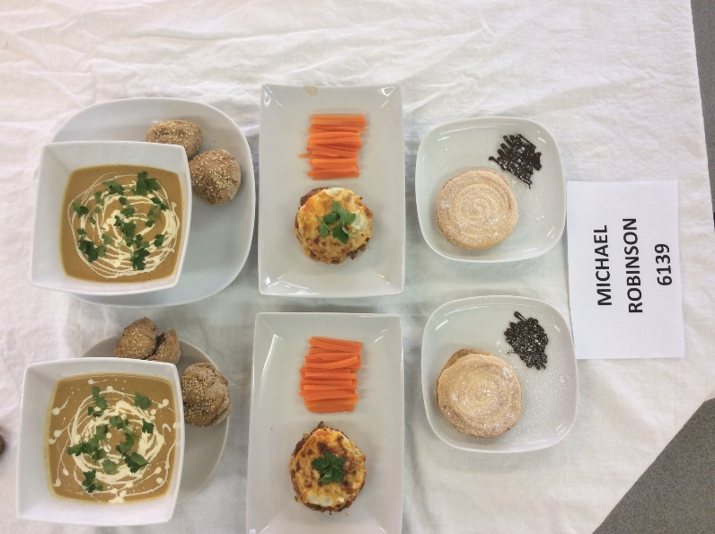
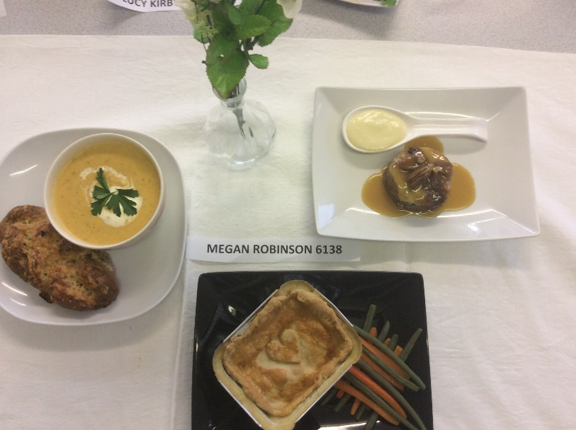
WELCOME TO WJEC LEVEL 3 DIPLOMA IN FOOD SCIENCE AND NUTRITION

Slide 2
Who will be teaching you?
Miss Ward
Miss Isaac

Slide 3
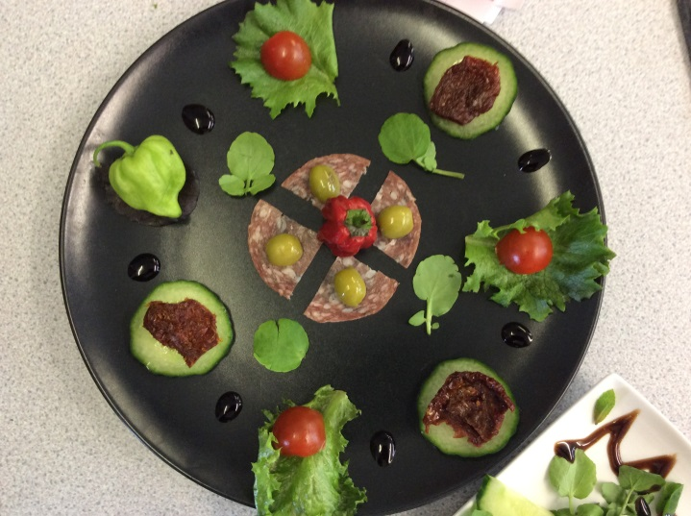
WHY STUDY WJEC LEVEL 3 DIPLOMA IN FOOD SCIENCE AND NUTRITION?
If you enjoy cooking and want to develop your practical skills as well as learning about healthy eating and the science behind the food we eat, then this is the course for you.

Slide 4
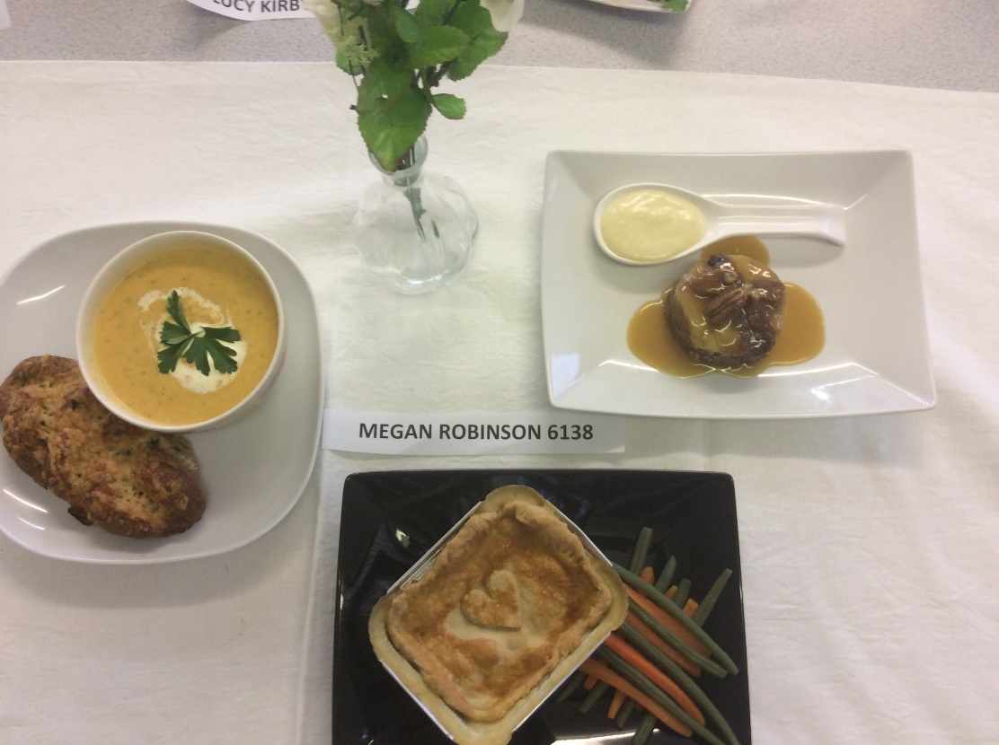
To be able to cook complex dishes

Slide 5
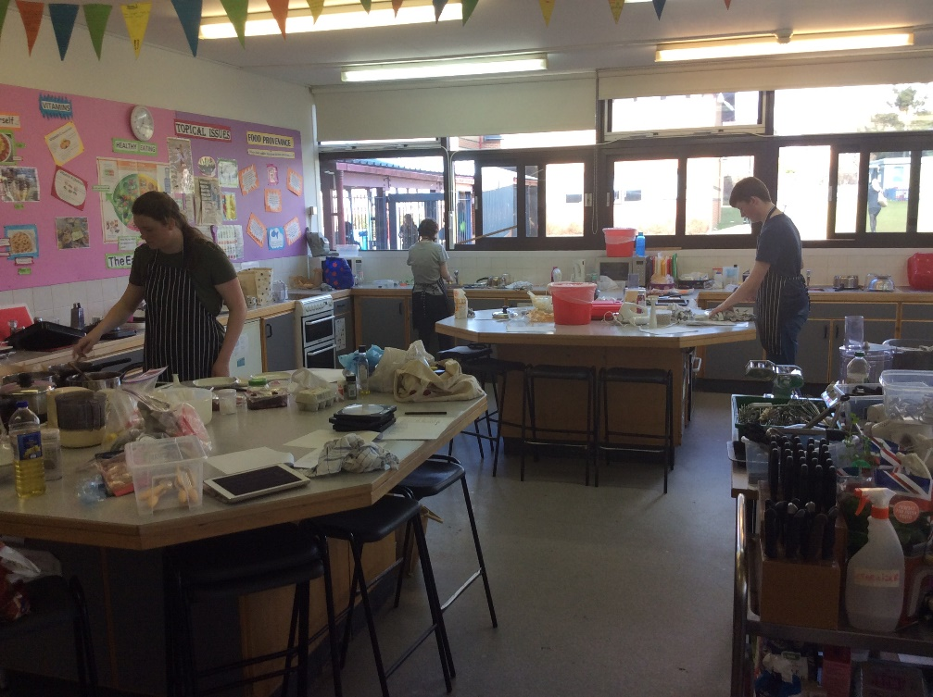
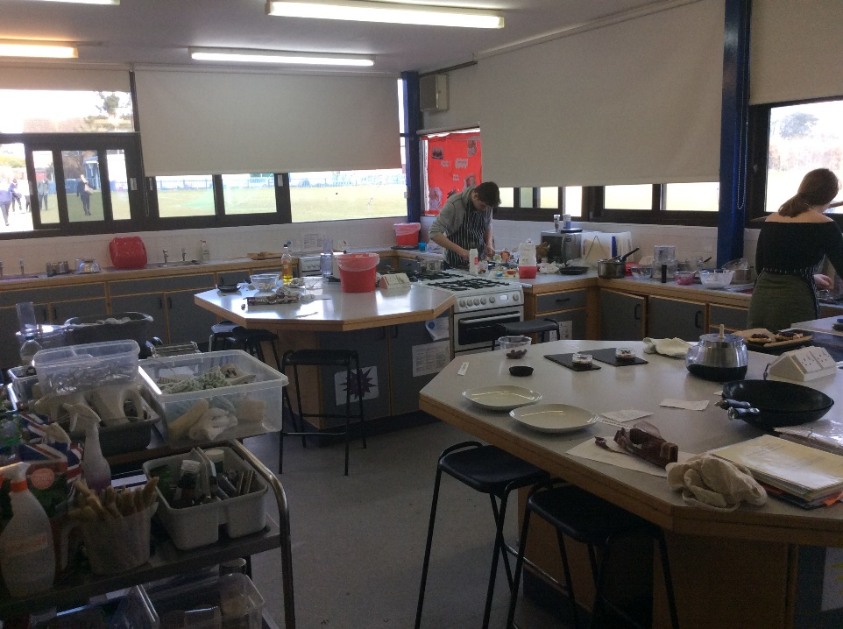

Slide 6
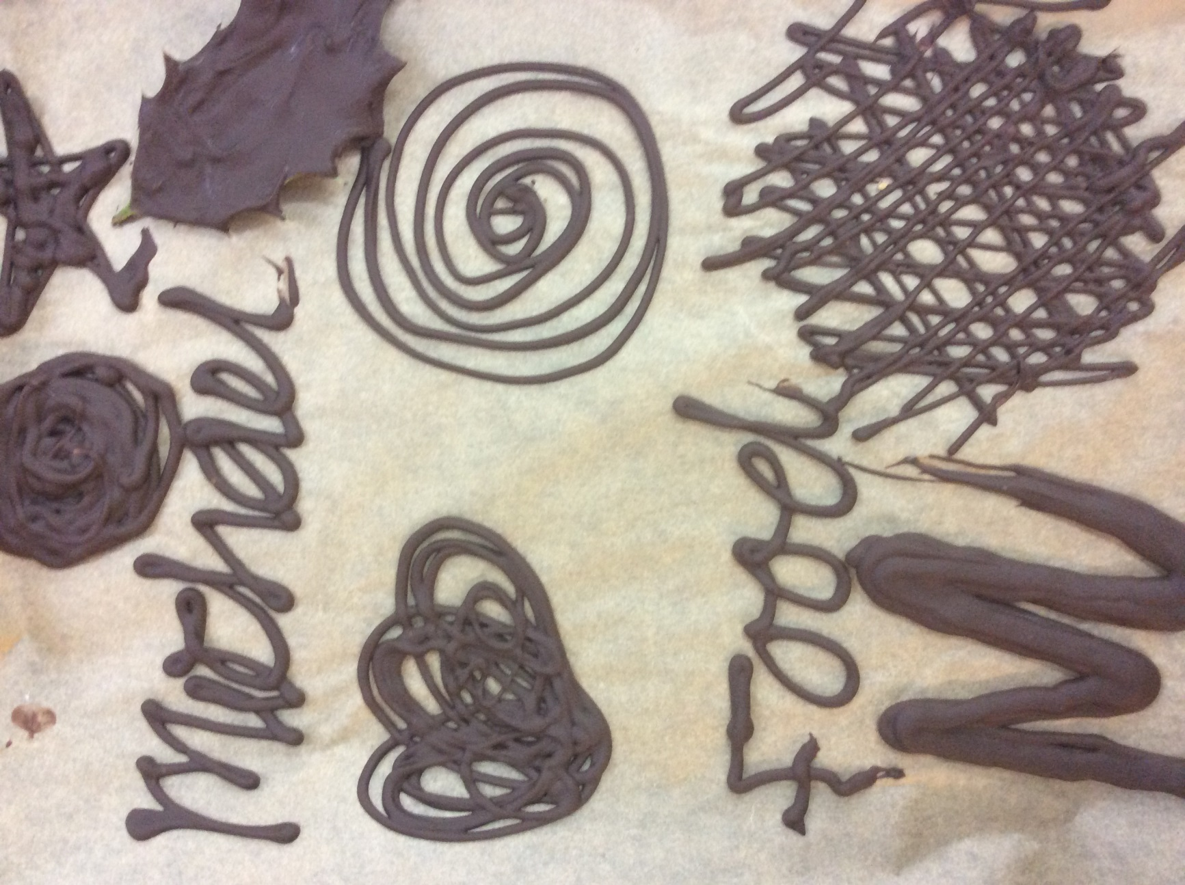
Chocolate Work

Slide 7
Sugar Work

Slide 8
Key Skills
Steaming
Poaching
Tenderising
ROASTING
Tandoori
Carving

Slide 9
Food Science and Nutrition
Key nutrients – chemical structure, function.
Understand the relationship between nutrients and the human body.
Evaluate fitness for purpose of diets.
Understand how micro-organisms affect food safety
Be able to scientifically investigate changes to food.

Slide 10
WHY STUDY WJEC FOOD SCIENCE AND NUTRITION?
An understanding of Food science and Nutrition is relevant to many industries and job roles. Over 500,000 people are employed in the UK food and drink sector in roles such as
Food Technologists, Nutritionists, Butchers, Chefs, Marketing Managers, Food Buyers, Dieticians, Environmental Health Officers, Food Stylists, Sports coaches and Fitness Instructors. Hotels and Restaurants, Food Manufacturers and Government Agencies also use this knowledge to develop menus, food products and policies that support healthy eating initiatives.

Slide 12
What will I study?
Unit 1 - Meeting the nutritional needs of specific groups
Coursework eg Improve the menu at a local spa focussing on teenagers.
Written exam example questions - writing a menu/dietary plan for a specific group.
Unit 2 - Ensuring Food is safe to eat e.g. food poisoning incident.
Unit 3 - Experimenting to solve Food production problems eg improve the recipe for Chelsea buns in a local bakery.
Unit 4 - Current issues in Food Science and Nutrition e.g. the new sugar tax, obesity in the UK.

Slide 13
How will I be assessed?
YEAR 12
Unit 1 –a 90 minute exam + 15 min reading time.
Unit 1 Coursework (9.5 hours), which includes a 3.5 hour practical exam.
YEAR 13
Unit 2 - A written assignment on ‘Ensuring food is safe to eat’. 8 hours to complete issued on 1st May in Year 13.
Centres can choose between unit 3 or 4.
Unit 3 – 12 hour assessment on Solving Food Production issues.
or
Unit 4 – 14 hour written report on current issues in Food Science and Nutrition.

Slide 14
How are the marks awarded
 | Time | % of final grade | marking | D UMS | M | P
Unit 1 exam | 90min + 15 m reading time | 25 | external | 80 | 60 | 40
Unit 1 timed assessment – | 9.5 hours includes a practical exam. 3 hours planning, 3.5 hours making and 3 hours evaluation. | 25 | internal | 80 | 60 | 40
Unit 2 – A written assignment on ‘Ensuring food is safe to eat’ Issued on May 1st completed within 3 weeks of being opened. | 8 hours | 25 | external | 80 | 60 | 40
Unit 3 or 4 Unit 3 –experimenting to solve food production problems Unit 4 - current issues in food science and nutrition. | 12 hour 14 hours | 25 25 | Internal internal | 80 80 | 60 60 | 40 40
total |  |  |  | 320 | 240 | 160

Slide 15
UNIVERSITY
UCAS points
D* = 56 (A*)
D = 48 (A)
M = 32 (C)
P = 16 (E)
The 1 year certificate will receive half these points.
Universities offering BSc Food Science/Nutrition Courses
- Almost 40 Universities including Leeds, Reading and Oxford Brookes

Slide 16
Trip with Year 13s to a local restaurant

Slide 17
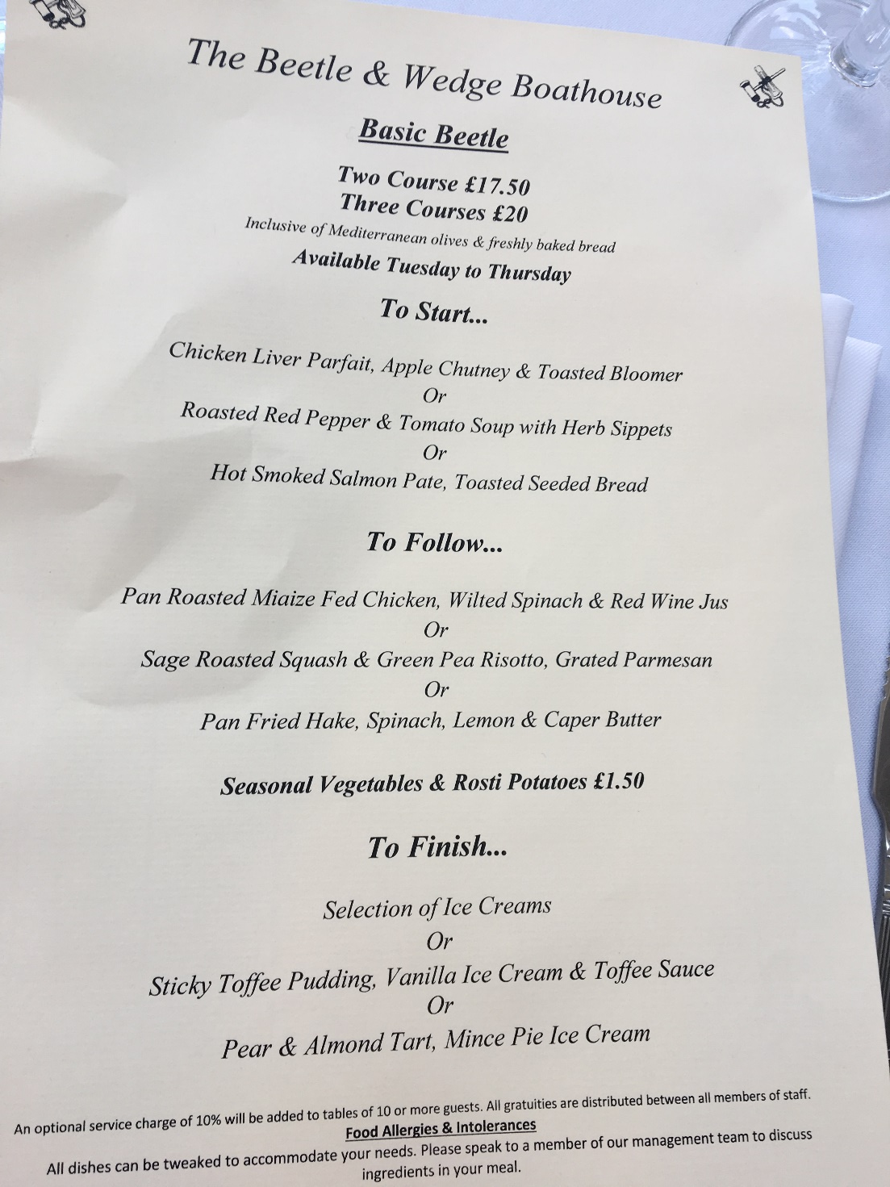

Slide 18
Unit 1 Meeting the nutritional needs of specific groups (exam)
Section A – short mark questions
Section B- long mark questions
Section C- Devising a dietary plan to meet the nutritional needs of a person

Slide 19
Section C Question Example
2. You need to devise a dietary programme that will meet his future needs 6 marks
3. Justify your dietary plan in relation to fitness for purpose. 10 marks

Slide 20
Unit 1 Meeting the nutritional needs of specific groups (coursework with practical exam)
3.5 hour practical exam
3 courses with 2 servings for each
Show a wide range of cooking and presentation skills

Slide 21
Examples from Unit 1 Practical Exam last year

Slide 22
Unit 2 Ensuring Food is safe to eat
Learn about food poisoning incidents and how to prevent them
Complete Food Safety and Hygiene Certificate
Understand the role of an Environmental Health Officer (EHO). Watch The Food Inspectors to find out what this is!

Slide 23
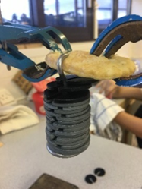
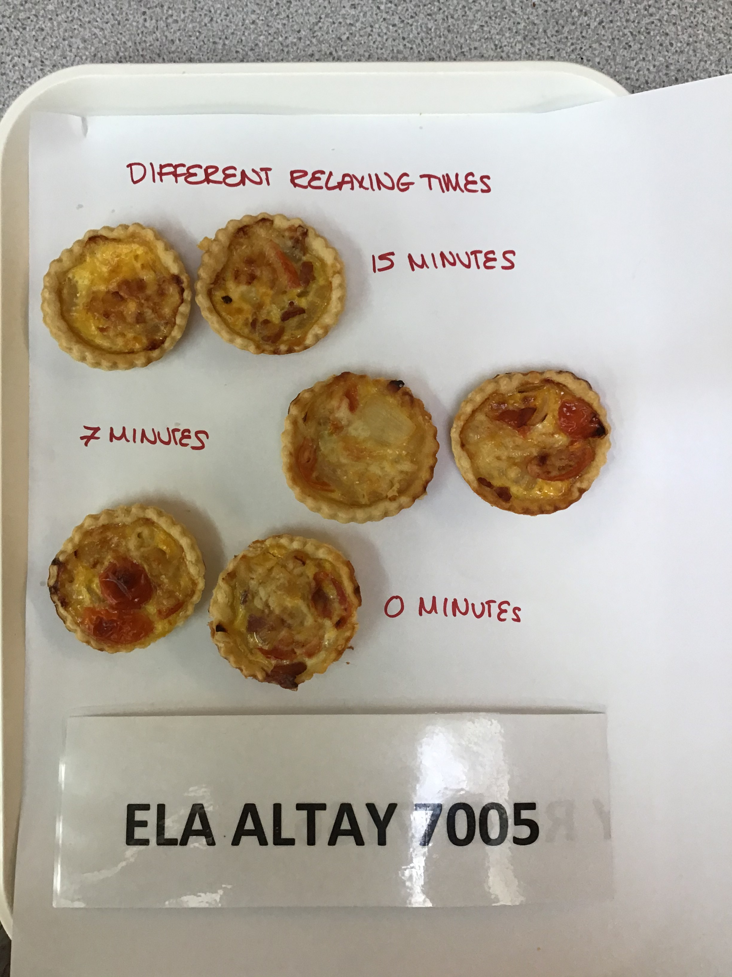
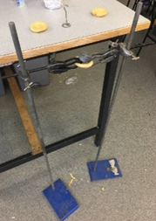
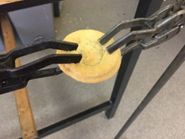
Unit 3 Experimenting to solve Food production issues

Slide 24
The Team – we look forward to teaching you.

