Slide 1
Year 10 Information Evening
Wallingford School
‘Able and Qualified’

Slide 2
The Y10 Team
Mrs L Burns- Head of Year 10 – burnsl@wallingfordschool.com
Ms R Miller – Deputy Headteacher & Raising Standards Leader – millerr@wallingfordschool.com
Tutors
Mr Flannagan
Ms Lancaster
Miss Maly
Mrs Ramsay
Mr Atkins
Miss Walker
Mrs Ward
Miss Wetherill ​
Mrs Atkins - SENDCO
Ms T Ward - Careers advisor​
Ms C Forno - School Health Nurse

Slide 3
Agenda
Able and qualified
Who we are – the year 10 team
The qualified part:
What we’re aiming for
Key dates and moments in the year
A few notes on how we learn
What should my child be doing?
How can I, as a parent/carer, support my child?
The able part

Slide 4
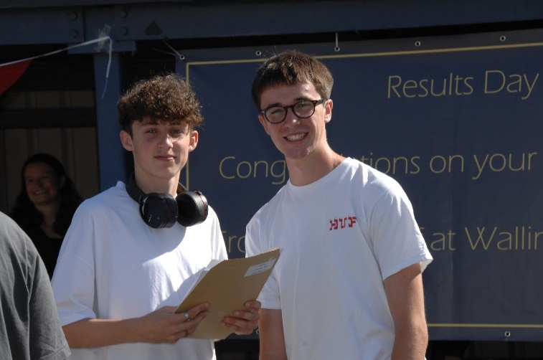
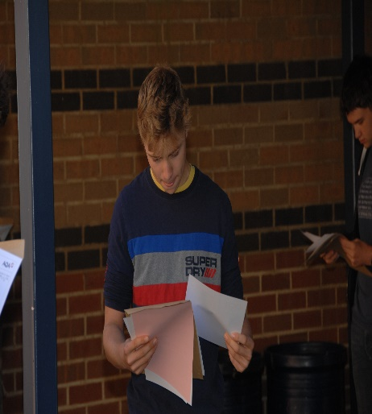
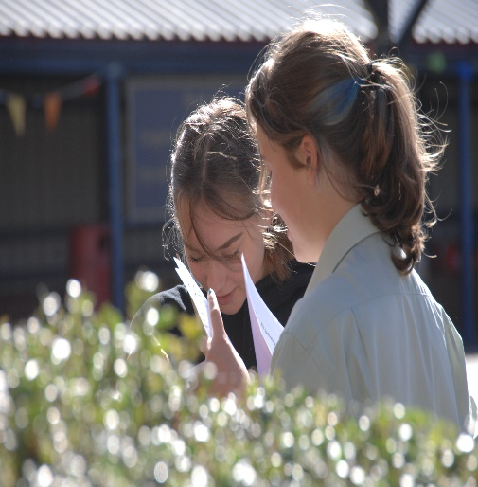
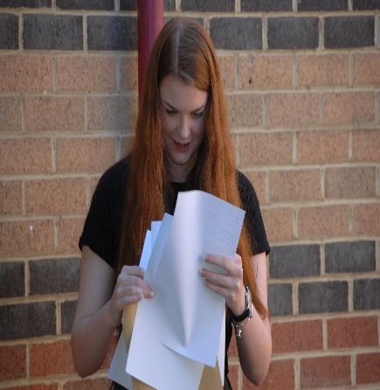
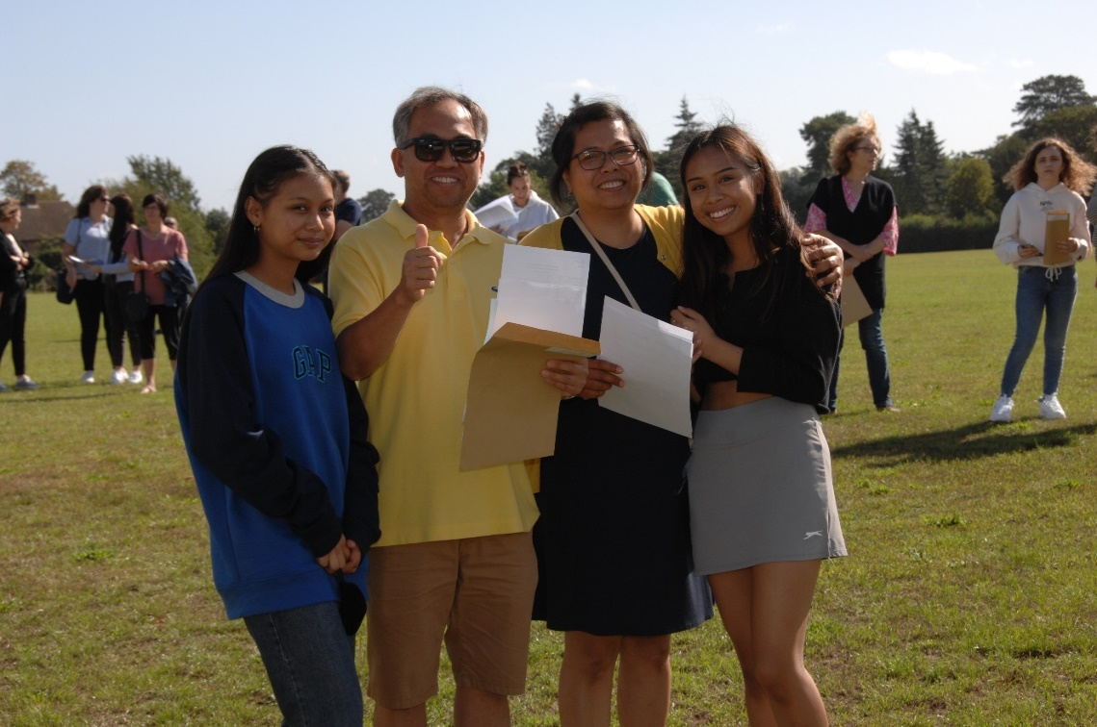
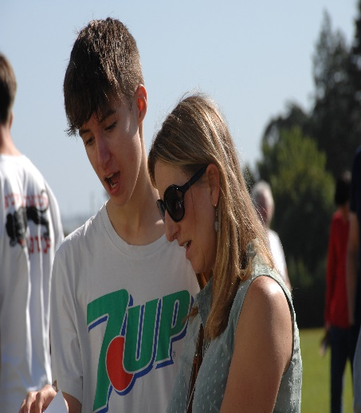
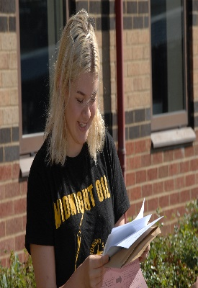
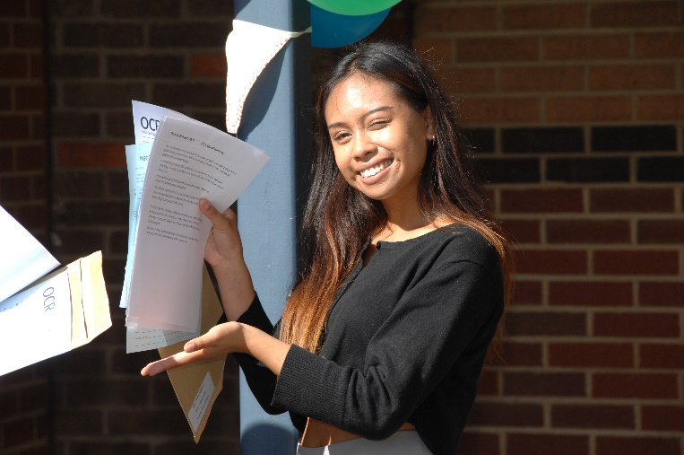
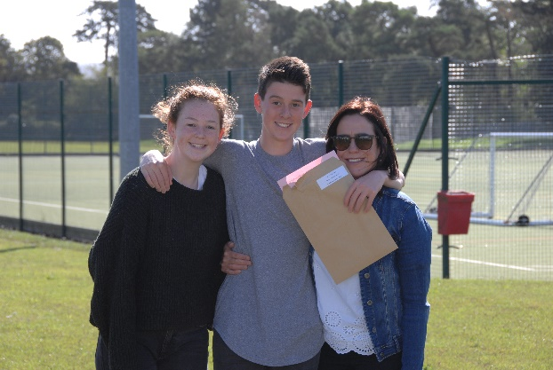

Slide 5
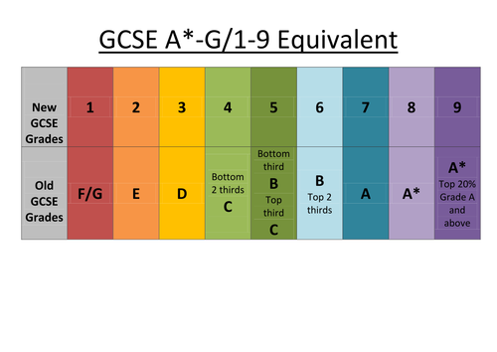
Qualifications & Grades
Vocational (L2)
D* Distinction Star
D Distinction
M Merit
P Pass
L1P Level 1 Pass
f

Slide 6
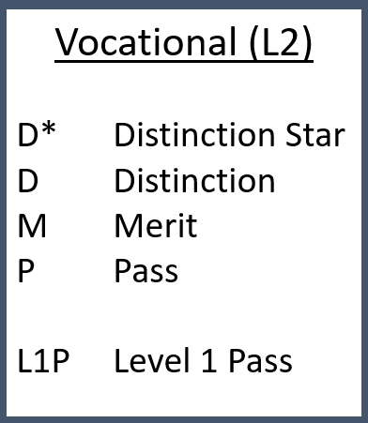
Qualifications & Grades
Key Considerations:
English and Maths
4s or 5s – BTECs
6s – A Levels

Slide 7
Important Dates for 2021/22
24th November – Progress Report 1
9th February Progress Report 2
17th February - Y10 Parents’ Evening
1st March – Y10 mock exams start
25th – 29th April – work experience week
8th July – Progress Report 3

Slide 9
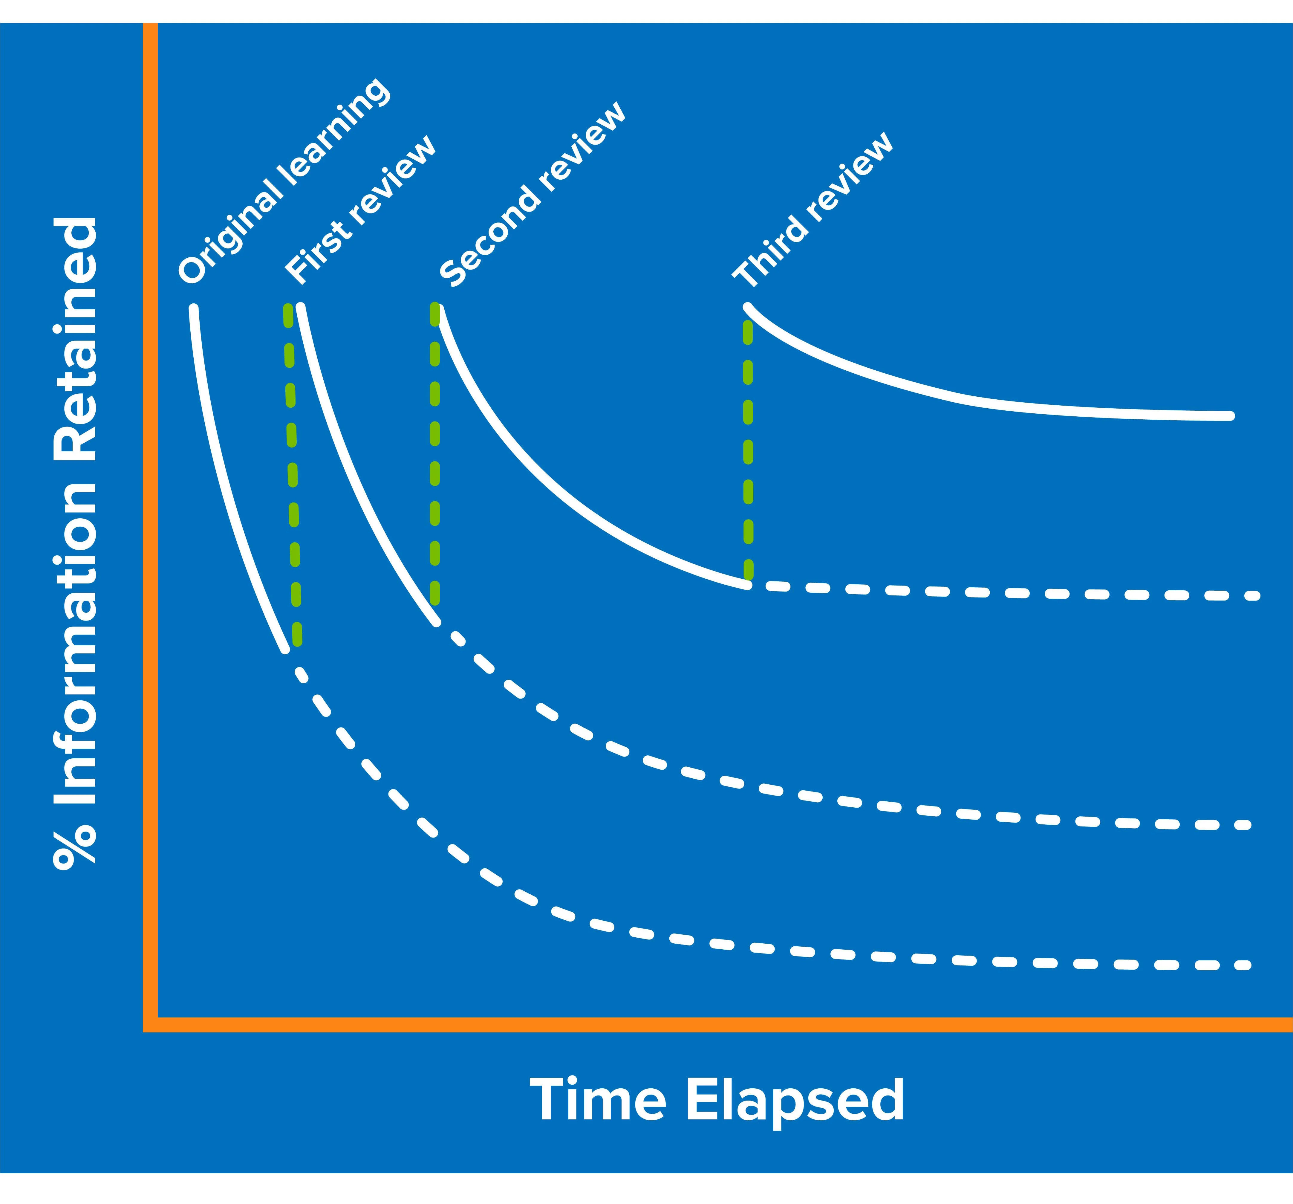
A note on forgetting
How to overcome the forgetting curve:
Plan to revisit topics (this is called revision!)
Revise topics shortly after learning them
Spaced learning
Reduce your cognitive load

Slide 10
What should my child be doing?
Attend school regularly
Complete all work to the best of their ability
Ensure all ‘coursework’ is completed and handed in on time
Take part in any intervention or revision activities
Revise and try their best for the mock exams
Tell someone if things aren’t going according to plan

Slide 11
But it’s not just about the exam results…
Post 16 pathways
PSHE programme
Trips and visits
Extra-Curricular activities
Celebration events

Slide 12
How can I support my child?
Make sure they attend school regularly
Help them form good study habits
Talk to them about what they are doing
Limit screen time
Encourage them to do things other than school work
Be firm and consistent
Tell us if there is a problem

